Slide 1
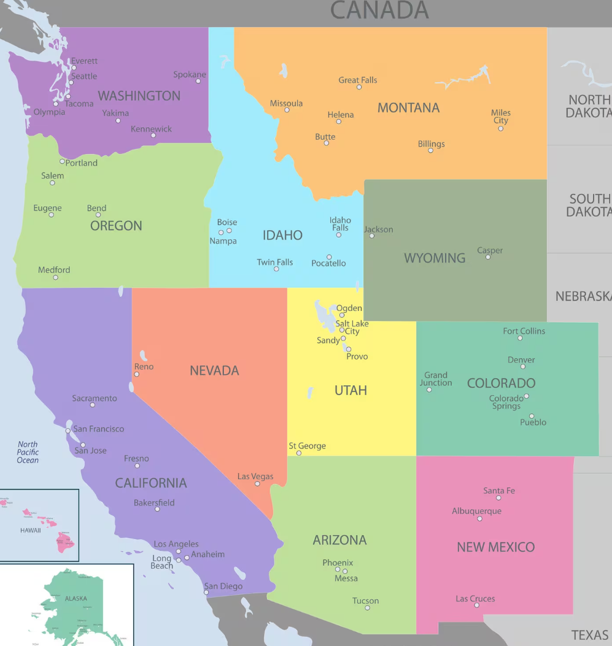
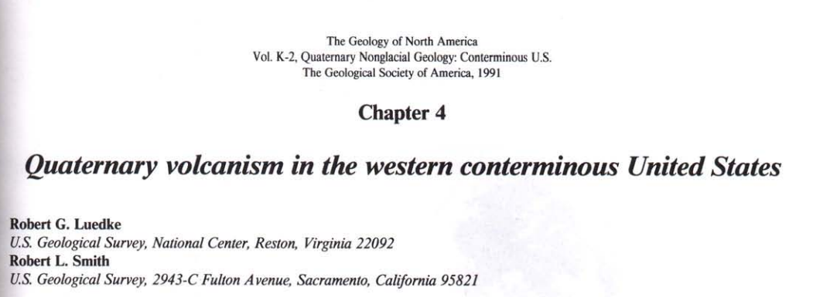
What are the patterns of volcanism in the Quaternary?
Luedke and Smith use “Quaternary” to cover the timespan from approximately the Pliocene to Holocene.
Utilizes hundreds of references
Later, when Luedke and Smith summarizes regions, you will note that these are meant to be “broad brush” strokes useful for getting a feel for the topic
https://www.mappr.co/political-maps/western-united-states-map/

Slide 2
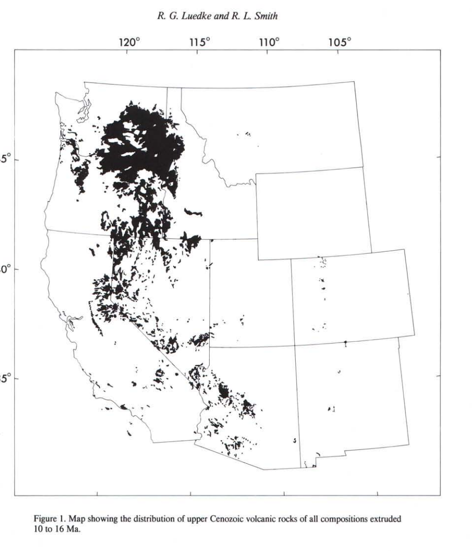
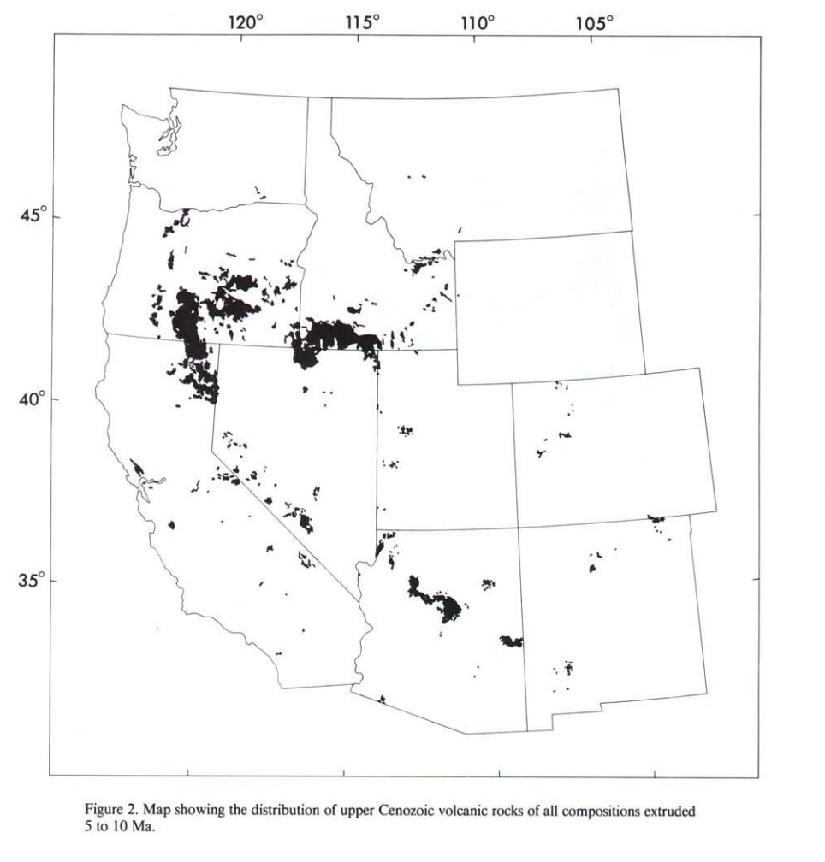
Volcanic Distribution: 5-10Ma
Volcanic Distribution: 10-16Ma
Mafic to felsic compositions
A notable province is the Columbia River Plateau basalts in Oregon, Washington, and Nevada
Mafic to felsic compositions
Different than earlier period
Less voluminous
Different vent sites generally

Slide 3
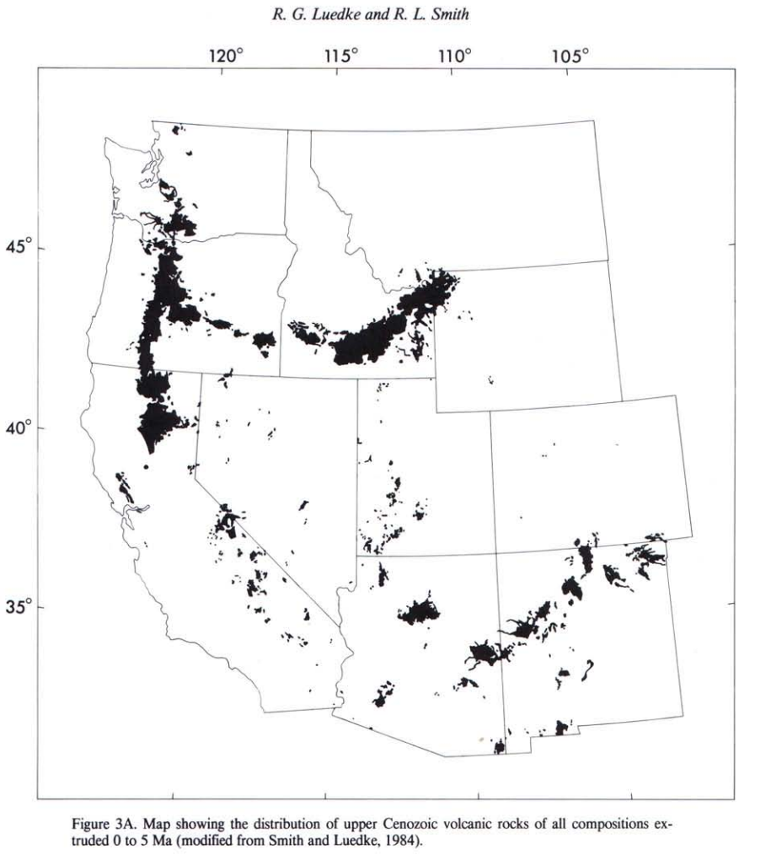
Volcanic Distribution: 5-10Ma
Volcanic Distribution: 0-5Ma
Linear trends
Share some volcanic loci with earlier 5-10 Ma period
Mafic to felsic compositions
Different than earlier period
Less voluminous
Different vent sites generally

Slide 4
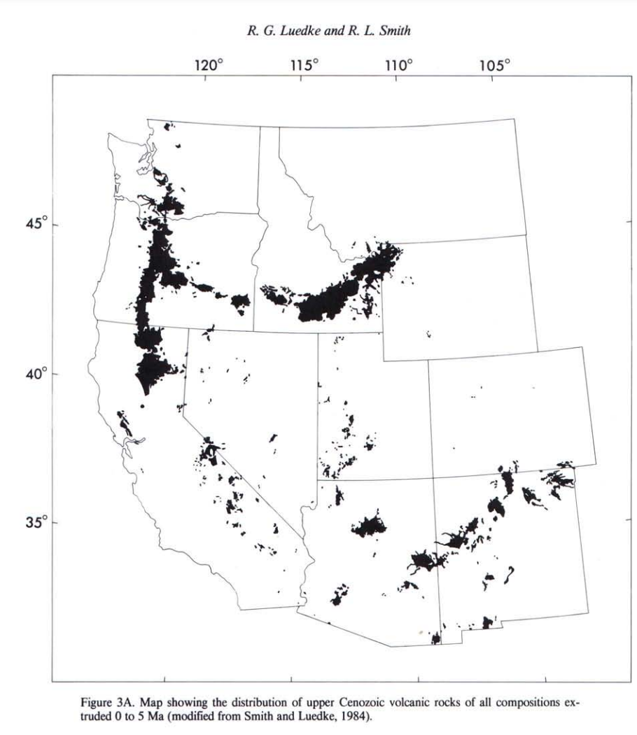
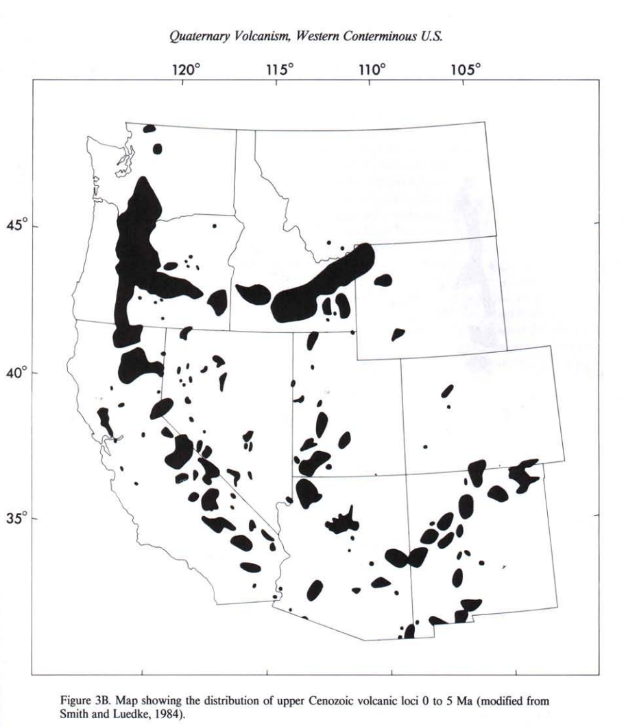
Volcanic Distribution: 0-5Ma
Volcanic Loci: 0-5Ma
Over 90 loci have been identified from 0-5Ma

Slide 5
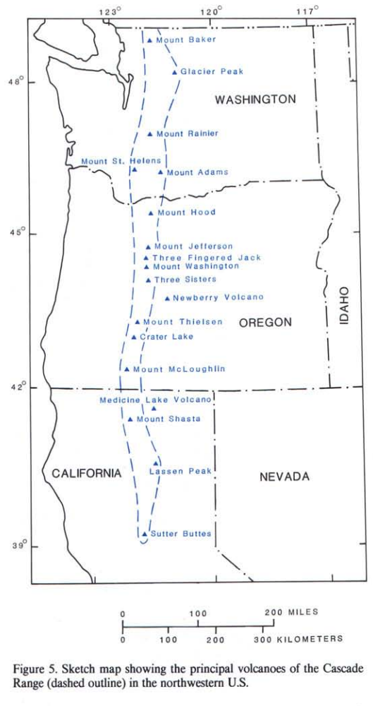
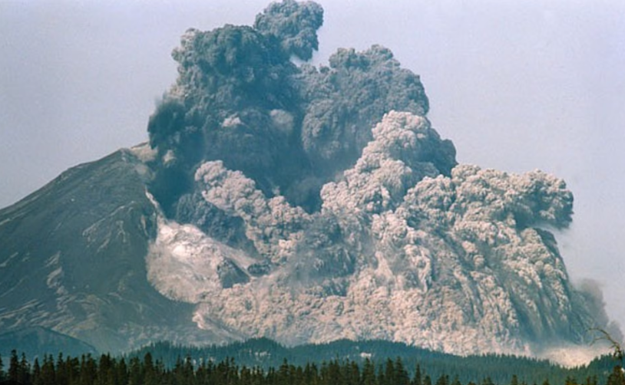
Quaternary Volcanism Centers: Cascades
Primarily stratovolcanoes with intervening smaller volcanoes and flows emanating from vents aligned along a N/S trend
Active primarily over the last 3 million years
Most activity thought to be younger than ~0.5 millions years
Andesitic to dacitic compositions generally
Mt. Saint Helens

Slide 6
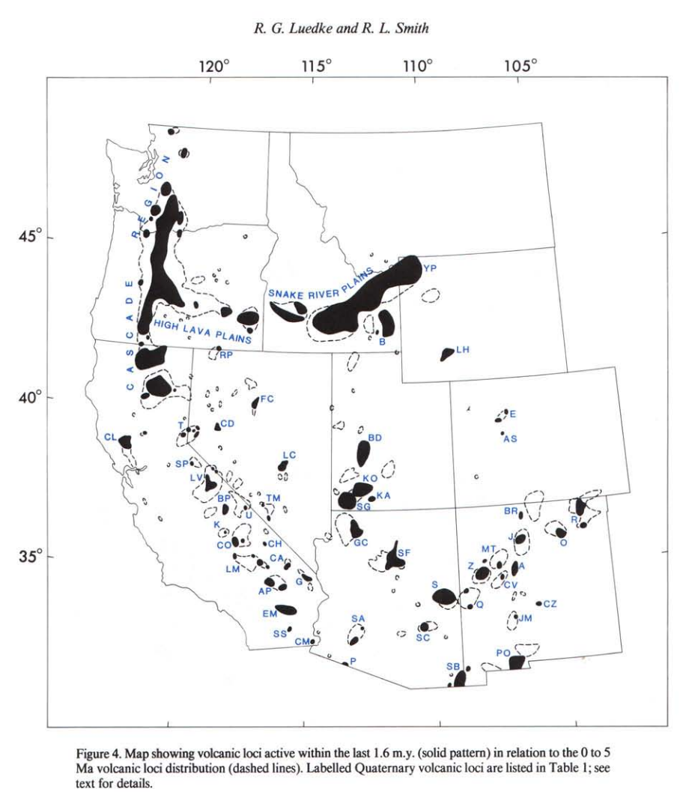
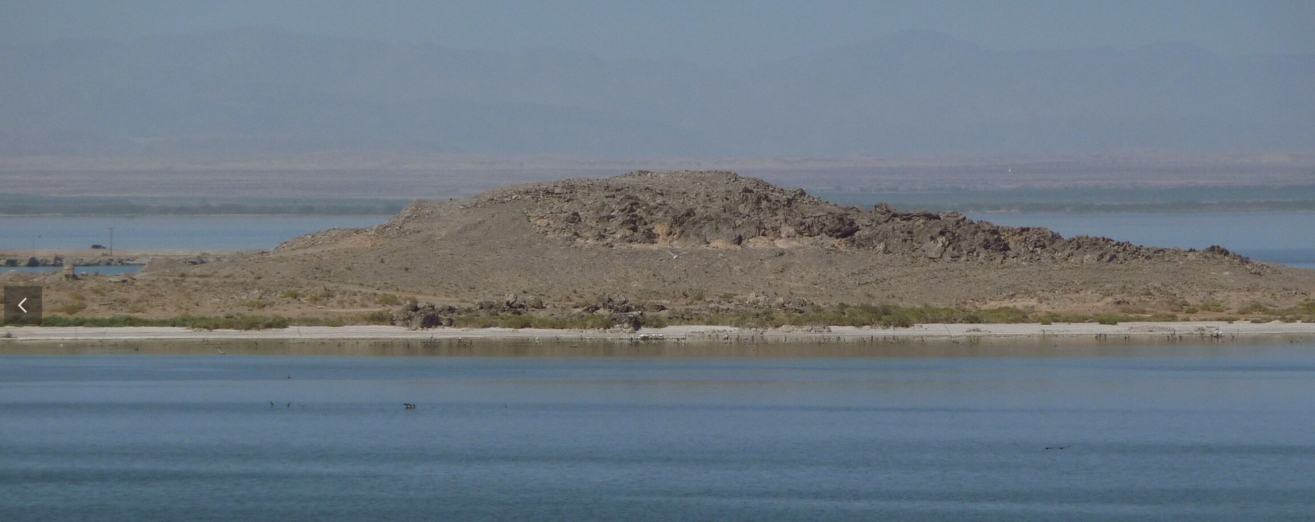
Quaternary Volcanism Centers: Eastern California to SW Arizona Belt
NW trend which Luedke and Smith suggest is associated with the Basin and Range
Varied compositions
Includes:
Long Valley caldera that produced high-silica (rhyolitic) tuffs
Mount Lassen which has been active intermittently since the Miocene
Rhyolitic domes surrounding the Salton Sea
Basaltic flows and dacite to andesite domes in southwest Arizona
Obsidian Butte (Salton Sea)

Slide 7
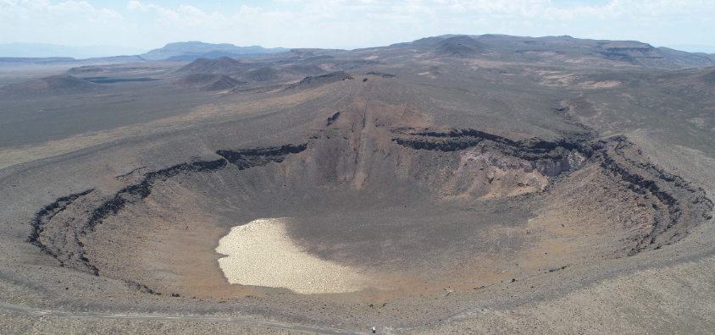
Quaternary Volcanism Centers: “Western Interior”
Coincides with Basin and Range in part
Includes:
High lava plains of Oregon that coincide with the Brothers fault zone (northern boundary of basin and range)
Basaltic to rhyolitic eruptions
Snake River Plain where basaltic shields volcanoes formed along the path of the Yellowstone hotspot
Lunar Crater (Nevada)

Slide 8
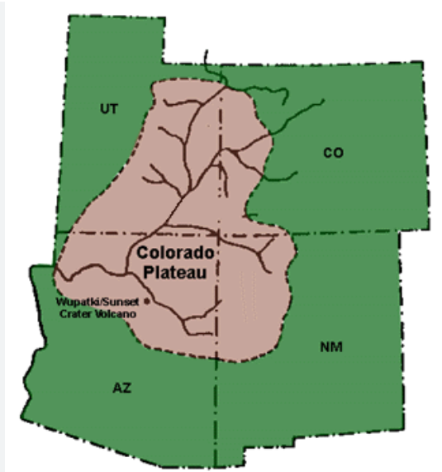
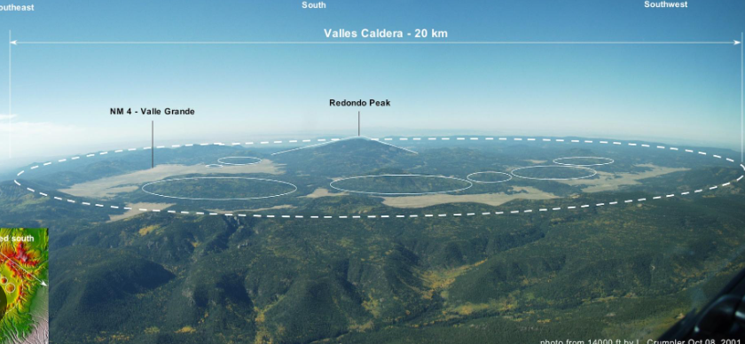
Quaternary Volcanism Centers: Colorado Plateau
Primarily basalt
Utah centers are marked by an eastward progression through time
New Mexico centers are influenced by Jemez lineament
Jemez (J) is a notable volcanic center and coincides with the intersection of the NE Jemez lineament with the Rio Grande Rift
Caldera
Valles Caldera (New Mexico)
nmnaturalhistory.org

Slide 9
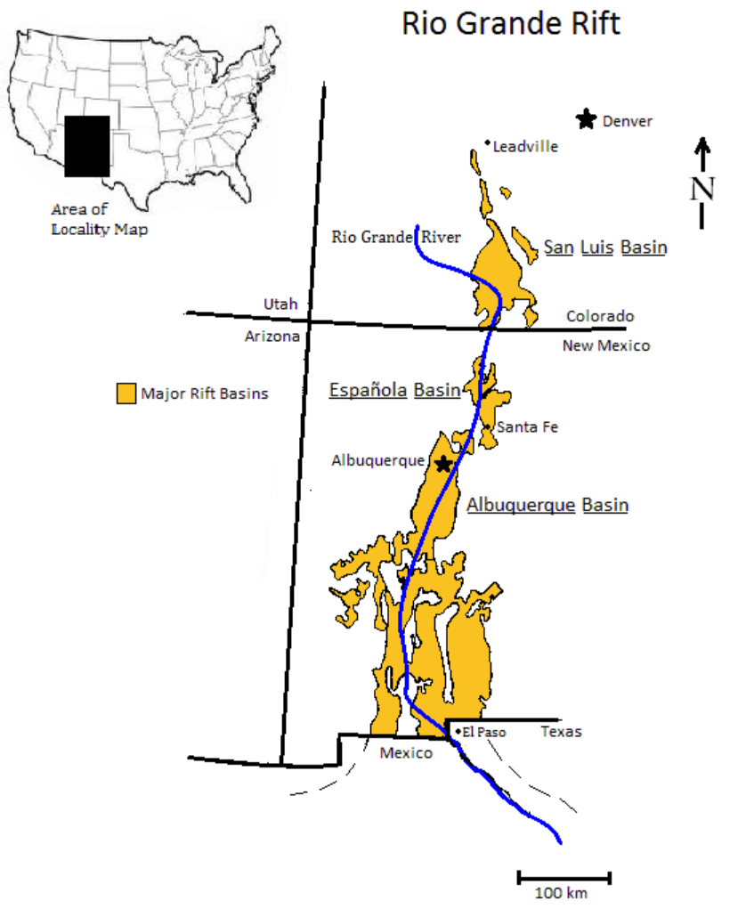
Quaternary Volcanism Centers: Rio Grande Rift
Separated the Rocky Mountains and Hight Plains to the east and the Basin and Range and Colorado Plateau to the west.
Primarily basalts
Relatively more active in the Pliocene
Secondarily influenced by Jemez lineament

Slide 10
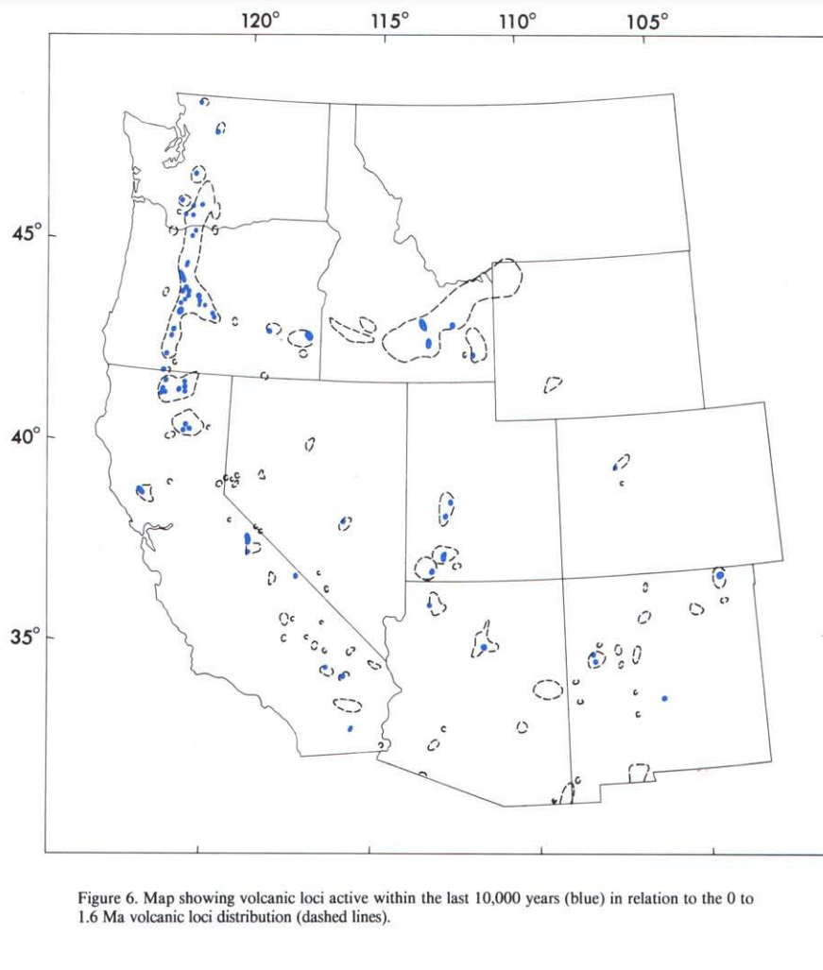
Volcanic Centers Now
Volcanic vents active during the past 10,000 years are found in the fingerprints of centers active over the past 1.6 Ma

Slide 11
Conclusions
Volcanic activity in the past 5 million years occurs in well-defined zones typically with linear trends
Tend to coincide with the boundary of geographic provinces
Vent shapes and trends may or may not reflect the underlying structural controls
Temporal migrations within certain regions can show consistent patterns (Utah) or be seemingly-random (Jemez lineament)

